Slide 1
Deep Sequential Architectures for Financial Time Series Classification
CMPE 679 Deep Learning Project Proposal
Obumneme Umeonwuka & Gloria Mbaka
Rochester Institute of Technology

Slide 2
Outline
Introduction
Research Question
Problem Motivation
Related Works
Architectures to be Evaluated
Training Modalities
Expected Outcomes

Slide 3
Introduction
Financial time series are nonlinear, noisy, and exhibit complex temporal dependencies. Traditional machine learning models fail to explicitly capture sequential structure.
This project investigates deep sequential neural architectures for short-horizon financial signal classification, evaluating MLPs, CNNs, RNNs (LSTM/GRU), hybrid CNN-RNN models, and attention-based architectures.

Slide 4
Research Questions
How do different sequential deep learning architectures compare in learning temporal representations for short-horizon financial direction prediction?

Slide 5
Problem Motivation
Financial markets generate sequential data with volatility clustering and regime shifts
Short-horizon prediction is challenging due to low signal-to-noise ratios
Classical ML models lack structured temporal memory
Deep sequential architectures explicitly model temporal dependencies

Slide 6
Related Works
Short-Horizon Market Predictability: Cryptocurrency markets exhibit high volatility and weak short-term autocorrelation. Jaquart et al. [1] show predictive performance is highly sensitive to horizon selection and chronological validation. This motivates strict time-based splits and careful target construction.
Convolutional Architectures: Bai et al. [2] demonstrate that convolutional sequence models can outperform recurrent networks in some sequence tasks. CNNs capture local temporal patterns using shared filters and can model longer dependencies via dilation.
Recurrent Architectures: LSTM [3] introduces gated memory cells to mitigate vanishing gradients. GRU [4] simplifies gating while maintaining competitive performance. Empirical evaluations in time series forecasting show strong performance of LSTM and GRU [5].
Hybrid CNN–RNN Models: DeepLOB [6] demonstrates that convolutional layers can extract hierarchical representations which are then modeled sequentially using recurrent networks. This motivates CNN-LSTM architectures for financial classification.
Attention and Transformers: Transformers replace recurrence with self-attention [8]. Temporal Fusion Transformer (TFT) extends attention mechanisms for interpretable multi-horizon forecasting [9]. Attention enables dynamic weighting of relevant timesteps.

Slide 7
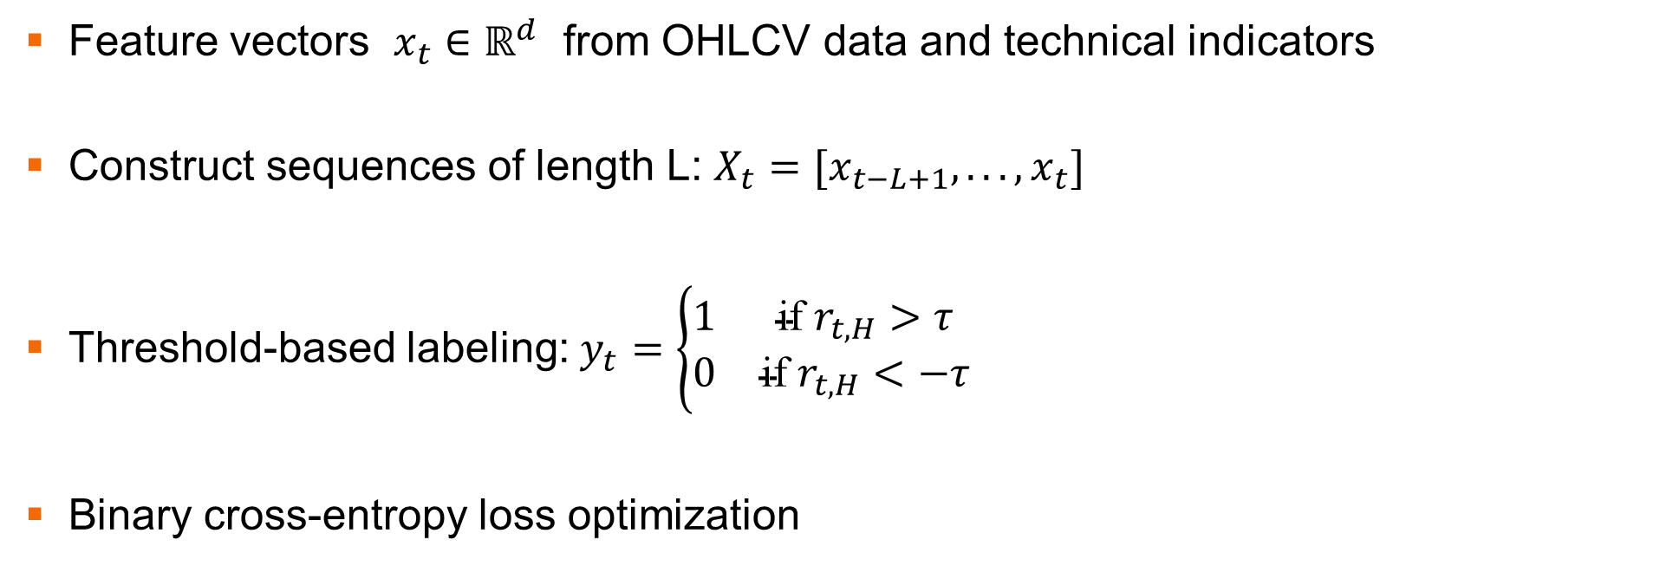
Problem Formulation
Feature vectors $x_{t}∈ℝ^{d}$ from OHLCV data and technical indicators
Construct sequences of length L: $X_{t}=[x_{t−L+1},...,x_{t}]$
Threshold-based labeling: $y_{t}=\left\{\begin{matrix}1 & \text{if} r_{t,H}>τ \\ 0 & \text{if} r_{t,H}<−τ\end{matrix}\right.$
Binary cross-entropy loss optimization

Slide 8
Architectures to be Evaluated
Data Source
High-frequency cryptocurrency data (Bitcoin 1-minute)
Key Features
OHLCV
RSI, MACD
Bollinger Bands
Rolling volatility
Momentum indicators
Baselines
Random Forest
Gradient Boosting
MLP
Deep Sequential
LSTM
GRU
CNN-LSTM
Transformer / TFT

Slide 9
Training Modalities
Regularization and Optimization
Dropout for preventing overfitting
Weight decay (L2 regularization)
Early stopping based on validation performance
Adam optimizer with learning rate scheduling
Classification Metrics
Accuracy
Precision and Recall
F1-score
ROC-AUC
Balanced Accuracy
Financial Metrics
Cumulative return
Sharpe ratio
Maximum drawdown
Win rate

Slide 10
Expected Outcomes
Sequential deep architectures outperform shallow baselines
CNN-RNN hybrids improve multi-scale pattern extraction
Attention-based models improve interpretability and long-horizon modeling

Slide 11
Conclusion
This study systematically compares shallow, recurrent, hybrid, and attention-based architectures for financial time series classification.
By applying rigorous evaluation and threshold-based labeling, we aim to provide insight into how deep sequential models learn temporal structure in noisy financial environments.

Slide 12
References
[1] P. Jaquart, D. Dann, and C. Weinhardt, “Short-term bitcoin market prediction via machine learning,” 2021.
[2] S. Siami-Namini et al., “The performance of LSTM and GRU networks in time series forecasting,” IEEE Big Data, 2018.
[3] Z. Zhang et al., “DeepLOB: Deep convolutional neural networks for limit order books,” IEEE Trans. Signal Processing, 2019.
[4] J. L. Lopez de Prado, ´ Advances in Financial Machine Learning. Wiley, 2018.
[5] S. Bai et al., “An empirical evaluation of convolutional and recurrent networks for sequence modeling,” 2018.
[6] A. Vaswani et al., “Attention is all you need,” NeurIPS, 2017.
[7] B. Lim et al., “Temporal Fusion Transformers for interpretable multihorizon forecasting,” Int. J. Forecasting, 2021.
[8] S. Hochreiter and J. Schmidhuber, “Long Short-Term Memory,” Neural Computation, 1997.
[9] K. Cho et al., “Learning phrase representations using RNN encoderdecoder,” EMNLP, 2014.
[10] I. Goodfellow et al., Deep Learning. MIT Press, 2016.

Slide 13
THANK YOU

